Slide 1

Solar Output Prediction Using Weather Data
Phase 1 Presentation
Geeta Naga Sai Amrutha Chandaluri
Pavan Kalyan Bellamkonda
Srija Adapa

Slide 2
PROJECT OVERVIEW:
This project is about predicting how much solar energy will be produced based on weather data like temperature, sunlight, cloud cover, and wind speed. As the world moves toward using more renewable energy, it's important to predict solar power accurately for better planning and managing energy resources. Solar power can be unpredictable because it depends on the weather, so this project uses machine learning to find patterns in the data and make better predictions. By comparing different machine learning models, we hope to improve how well we can forecast solar energy output and help ensure a steady supply of renewable energy.

Slide 3
Literature Review
Here's a brief literature review highlighting some key studies and approaches in the field of solar output prediction.
1. "Predicting Solar Generation from Weather Forecasts Using Machine Learning" by Navin Sharma et al. (2011)
This study proposes using Linear Regression and Support Vector Machines on weather data for predicting solar output. They explore features such as Temperature, Dewpoint, Windspeed, Sky cover, Precipitation and Humidity to predict solar output.
Used Linear Least Square Regression and Support Vector Machine
2." Forecasting Day-Ahead Solar Radiation Using Machine Learning Approach" by M. Z. Hassan et al. (2017):
M.Z.Hassan et al. compare multiple regression techniques for generating prediction models, including linear least squares and support vector machines using multiple kernel functions. They analyzed predictions for day ahead solar radiation data and show that a machine learning approach yields feasible results for short term solar power prediction.
Used Multiple Regression Techniques and Kernel Based SVM Models

Slide 4
What’s New
Using Real Time data of 25 years for solar prediction
Implementing Neural Networks
Implementing LSTM
Implementing ARIMA

Slide 5
Our Dataset
The dataset is a collection of solar output based on weather data
https://nsrdb.nrel.gov/data-viewer
Number of files: 25
Total size:51 MB
Number of rows: 438000
Number of columns: 24

Slide 6
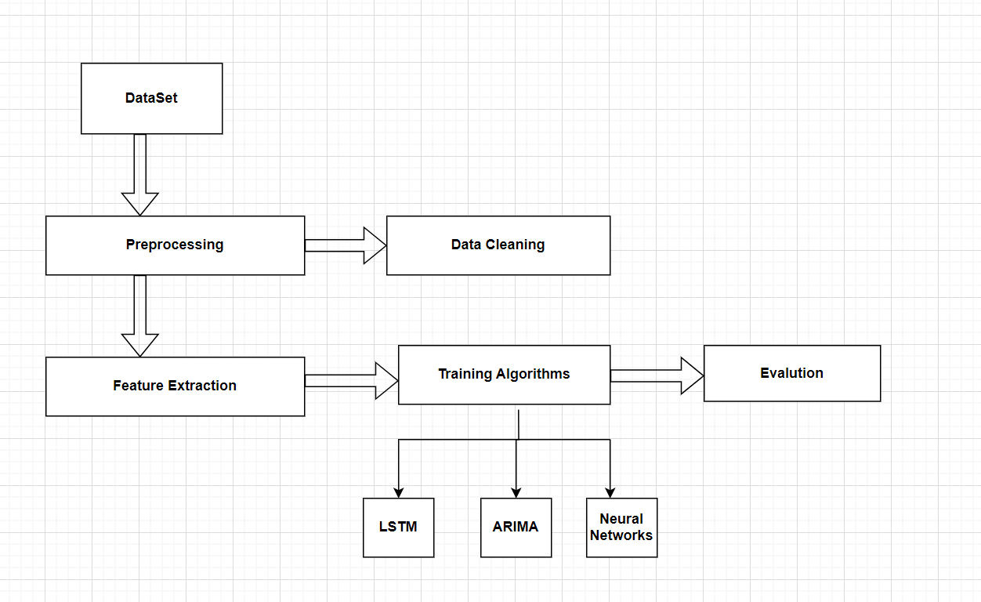
Our Approach

Slide 7
Data Preprocessing
Data Loading
Data Cleaning
Feature Engineering
Data Visualization

Slide 8
Performing EDA
Step 1: Data Loading We combined 25 datasets spanning from 1998 to 2022 into a single dataframe for easier analysis.
Step 2: Data Cleaning We removed columns with null values or those that had minimal relevance to solar energy output prediction.
Step 3: Feature Engineering Out of the 24 original columns, we selected the 13 most relevant features for further analysis.
Step 4: Data Visualization To identify trends and insights, we created various visualizations. These graphs helped us better understand the relationships between weather variables and solar energy output, guiding us toward selecting the right machine learning models.

Slide 9
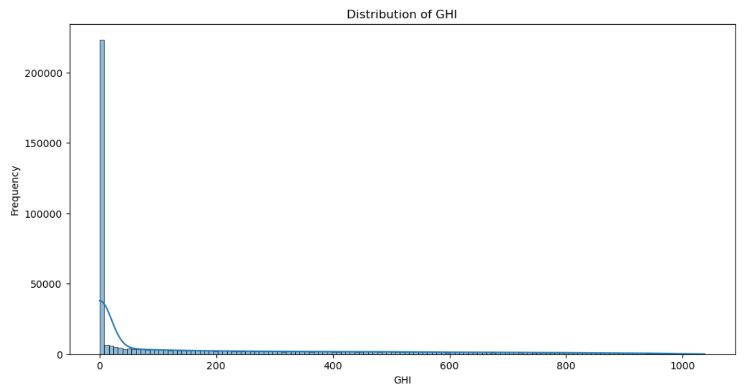
Data Visualization Frequency of GHI

Slide 10
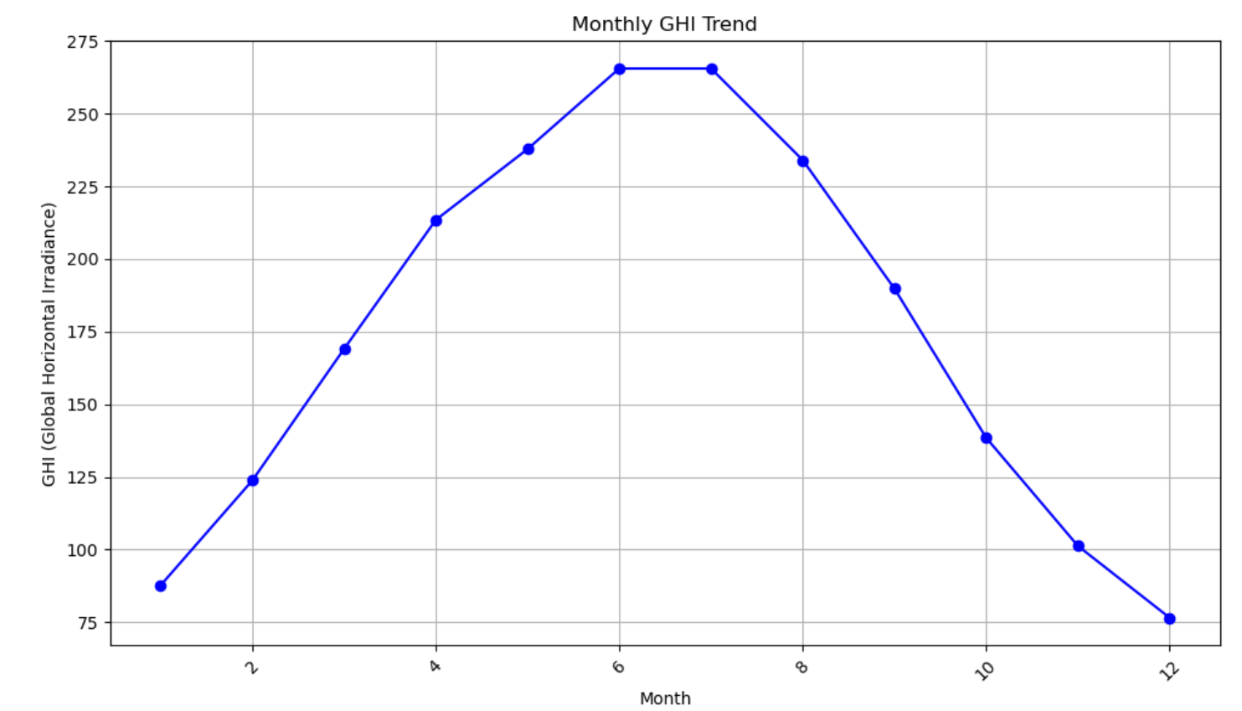
Monthly GHI Analysis

Slide 11
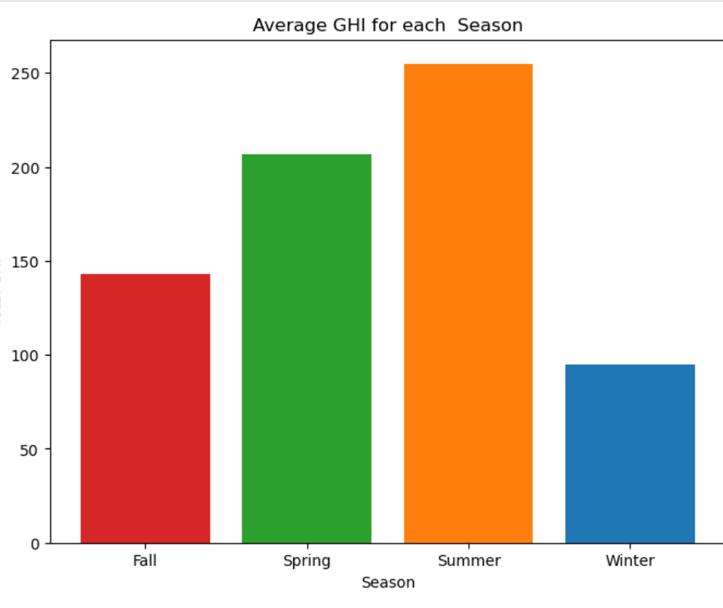
GHI for Each Season

Slide 12
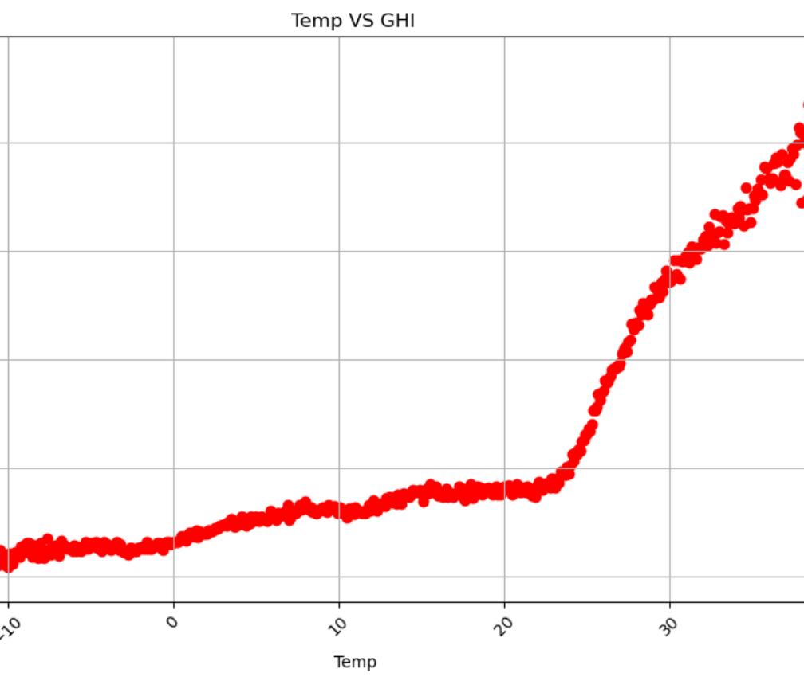
Temp Vs GHI Generated

Slide 13
References
https://www.semanticscholar.org/paper/Forecasting-Day-Ahead-Solar-Radiation-Using-Machine-Hassan-Ali/93eb34d2dd9bcb103be272c7481dd45f77e58be5https://lass.cs.umass.edu/papers/pdf/smartgridcomm11-solar.pdf
https://cs229.stanford.edu/proj2019spr/report/91.pdf

Slide 14

Thank you

